Slide 1

Egypt-Air website Redesigning
Old Design vs Improved Design

Slide 2

01
Project OverView
A Presentation OverView

Slide 3



OverView
Project Overview
In the ever-evolving world of travel, EgyptAir stands out with a robust online presence designed to cater to the needs of modern travelers. As Egypt's flagship airline, EgyptAir has made significant strides in digital innovation to streamline the travel experience. This project aims to redesign the EgyptAir website to enhance user experience, making it more intuitive, efficient, and responsive to the needs of today's travelers

Slide 4

02
Old Design

Slide 5
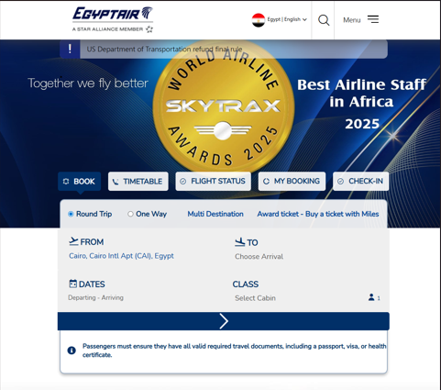
Home page ( Header)
Product 1
Product 1

Slide 6
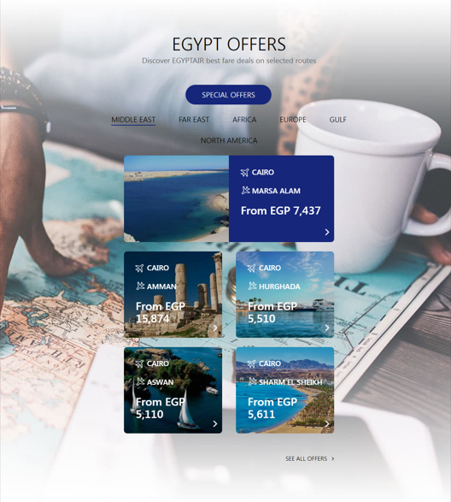
Home page ( body (1))
Product 1
Product 1

Slide 7
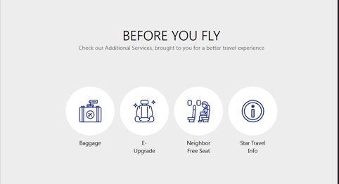
Home page ( body (2))
Product 1
Product 1

Slide 8
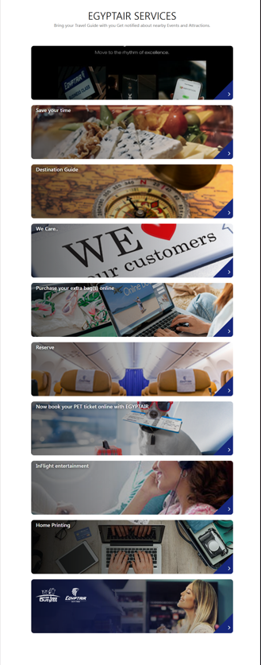
Home page ( body (3))
Product 1
Product 1

Slide 9
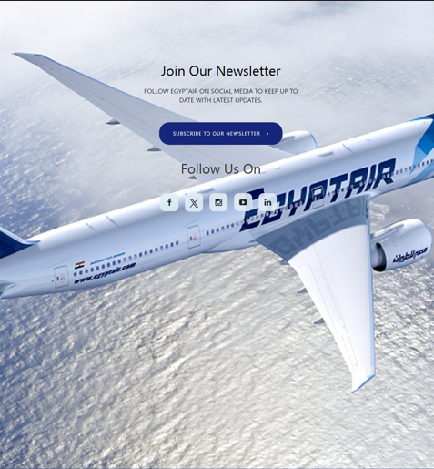
Home page ( Footer(1))
Product 1
Product 1

Slide 10
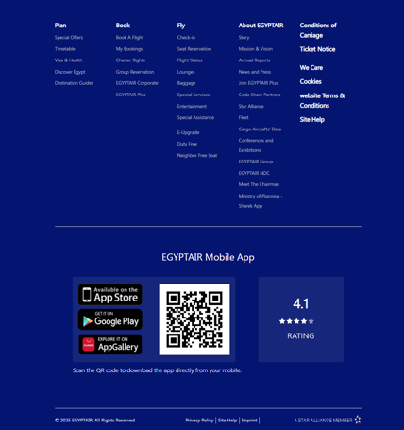
Home page ( Footer(2))
Product 1
Product 1

Slide 11




Old Design Issues (Home page )
Product 1
Weak Visual Hierarchy
. Footer Information Overload
There is no clear hierarchy guiding the user’s attention. Important elements such as booking actions, offers, and services compete visually instead of following a clear top-to-bottom priority.
The footer contains a large amount of information presented at once, which can overwhelm users and make it difficult to locate specific links efficiently.
Inconsistent Spacing and Alignment
Lack of Modern UI Refinement
Presentations are communication tools that can be used as demonstrations, lectures, speeches, reports, and more. Most of the time, they're presented before an audience.
While functional, the overall design lacks modern UI polish, such as refined typography, consistent iconography, and smoother visual transitions, which could enhance the perceived brand quality..

Slide 12
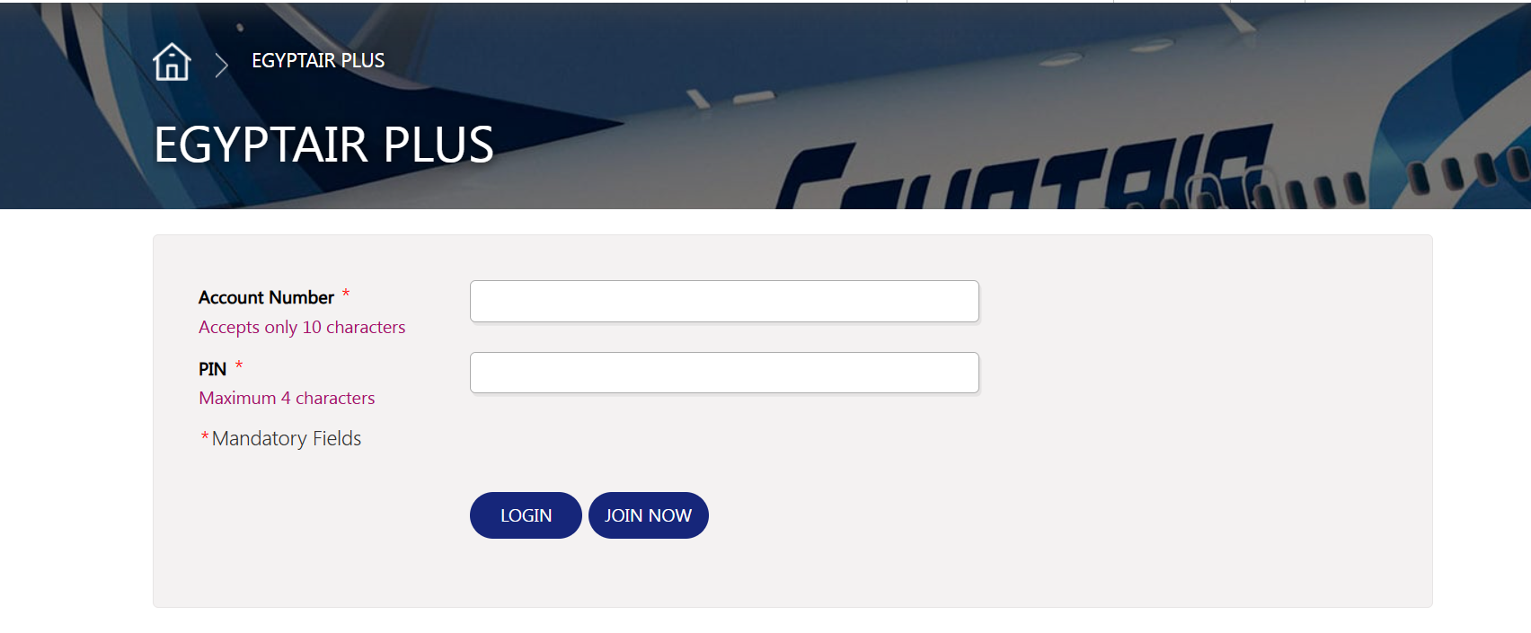
Login Page
Product 1
Product 1

Slide 13


Old Design Issues (Login page )
Product 1
Excessive empty space
. Unclear primary vs secondary action
There is too much unused white space around the form, which makes the page feel sparse and less focused.
“Login” and “Join Now” buttons look almost identical, which can confuse users about the main action.
Not visually modern
Missing “Forgot PIN?” option
The overall look feels outdated compared to current airline or loyalty program UI standards.
There is no visible recovery link for users who forget their PIN, which can cause frustration and increase support request.

Slide 14
02
Improved Design

Slide 15
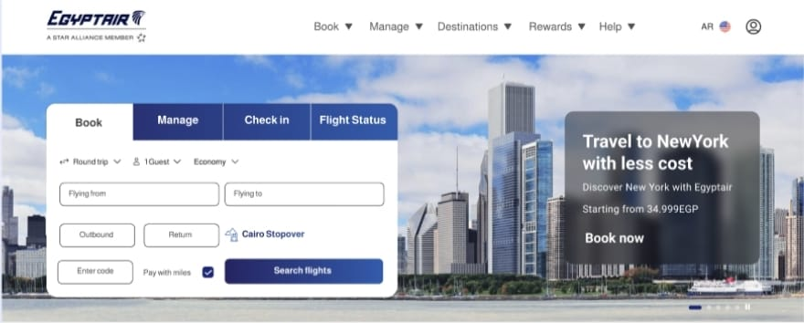
Home page ( header)
Product 1
Product 1

Slide 16
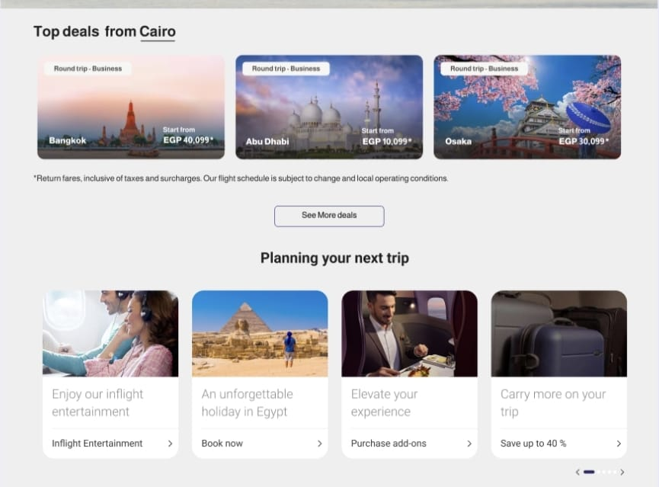
Home page ( body(1))
Product 1
Product 1

Slide 17
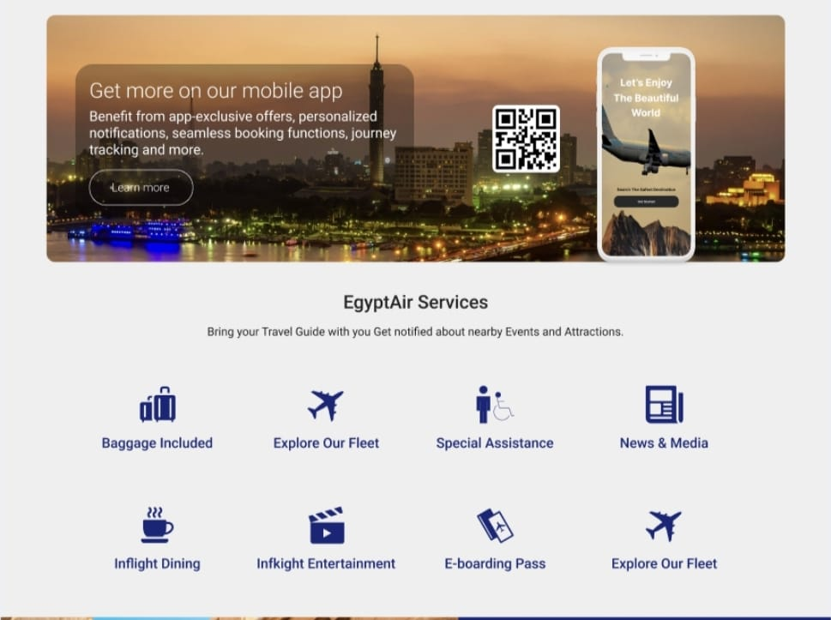
Home page ( body(2))
Product 1
Product 1

Slide 18
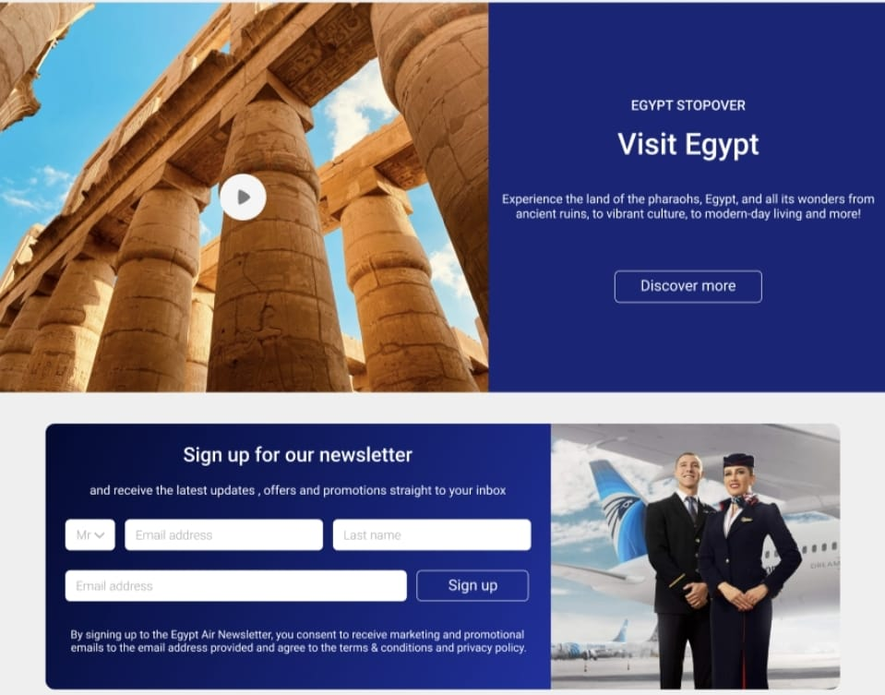
Home page ( body(3))
Product 1
Product 1

Slide 19
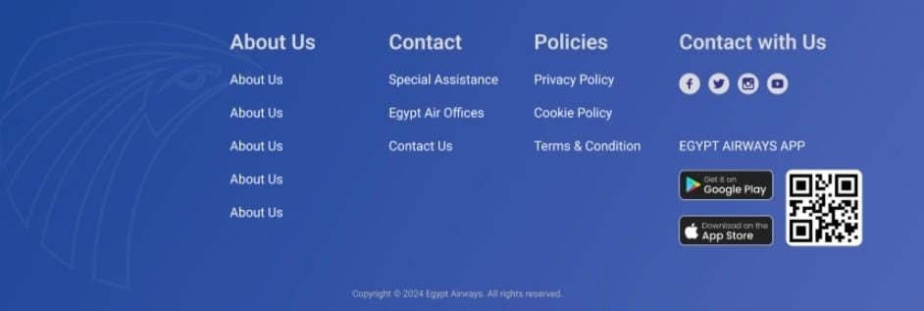
Home page ( Footer)
Product 1
Product 1

Slide 20
Design Improvements (Home Page )
Product 1
Improved Visual Hierarchy
. Enhanced Footer Structure
The redesigned layout establishes a clearer visual hierarchy by prioritizing key actions such as booking, deals, and trip planning. Headings, cards, and CTAs are now more distinguishable, guiding users smoothly through the page
The footer is more structured, with clearer categorization of links, social media, and app downloads, improving usability and navigation.
Cleaner and More Organized Layout
Enhanced Readability and Contrast
Content is better structured into clearly defined sections (Offers, Services, Newsletter, Mobile App, Footer), reducing visual clutter and making the page easier to scan and understand.
Text contrast has been improved across sections, especially on image backgrounds. This enhances readability and accessibility while ensuring important messages stand out..

Slide 21
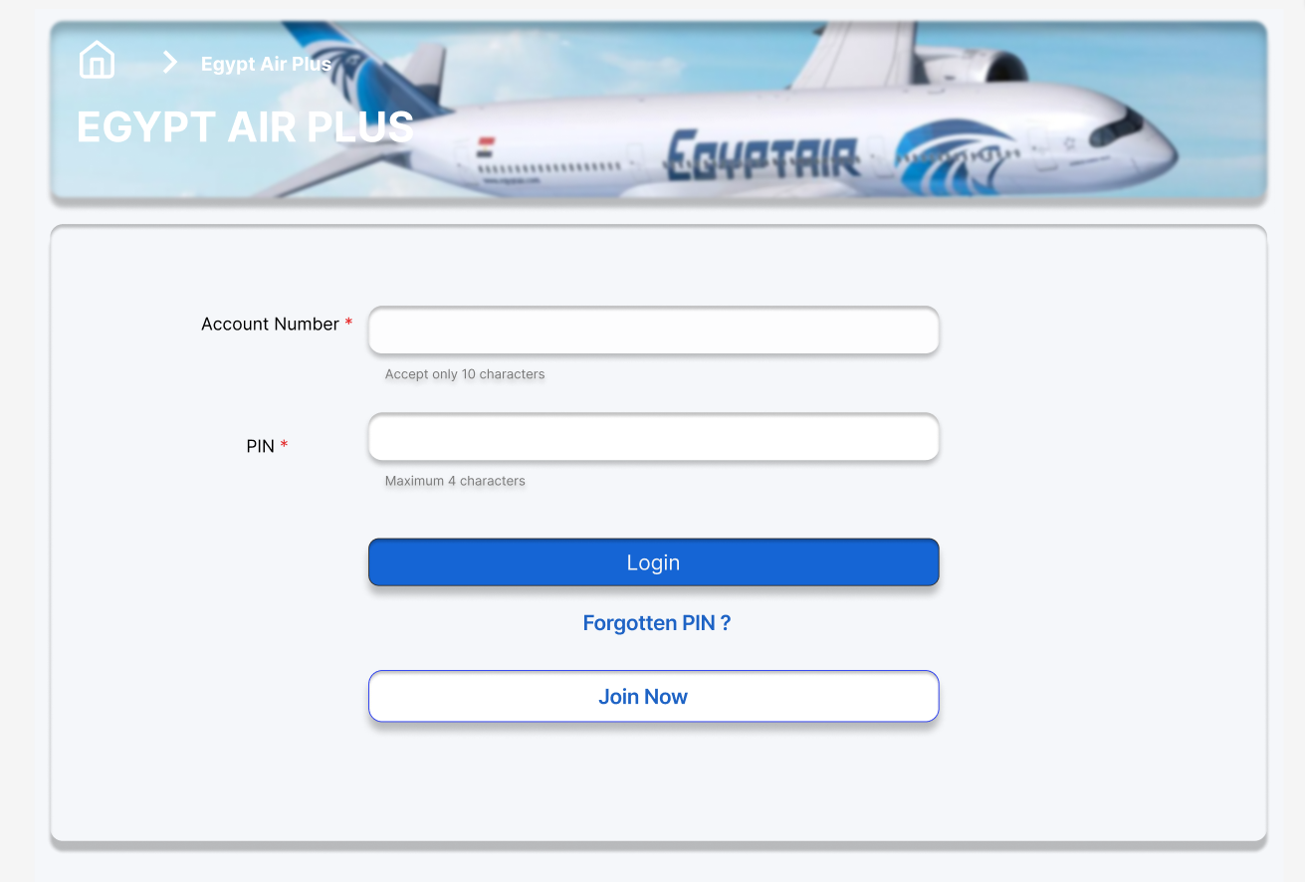
Login Page
Product 1
Product 1

Slide 22
Design Improvements (Login Page )
Product 1
Better spacing and alignment
. Added “Forgotten PIN?” option
Elements are evenly spaced and centered, which improves readability and overall balance
A clear recovery link is now available, improving usability and reducing user frustration.
More modern and professional look
Clear distinction between actions
Rounded corners, soft shadows, and consistent colors give the interface a more contemporary feel
“Login” and “Join Now” buttons now have different visual styles, reducing confusion between primary and secondary actions.

Slide 23
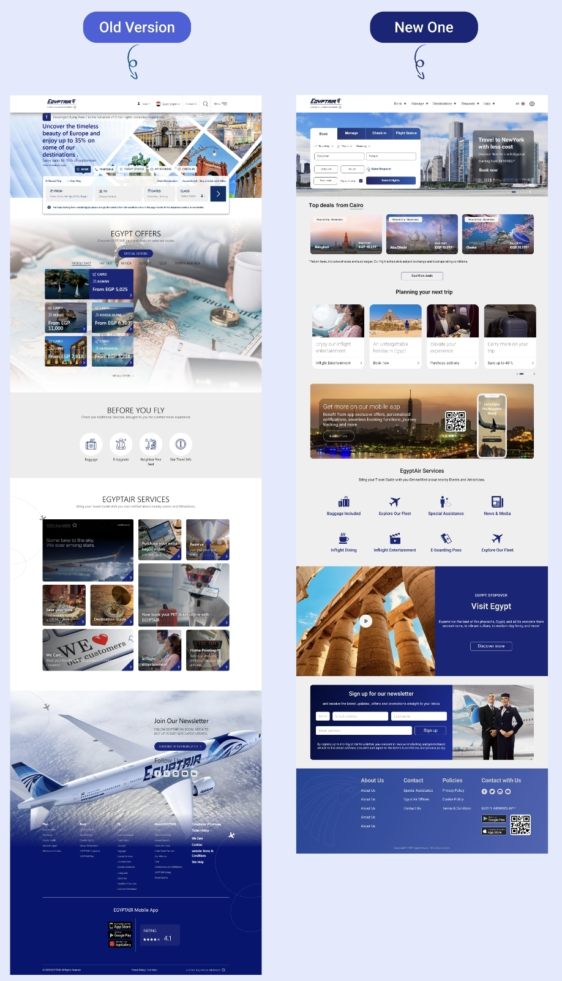
Old Version VS New Version
Product 1
Product 1

Slide 24
THANK YOU

